Slide 1

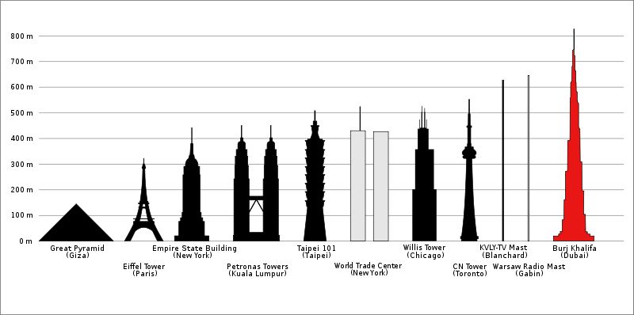
What is the tallest free standing structure on land today?

Slide 2

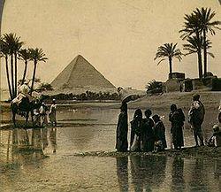
Height
146 meters
Record
2570 BCE to 1311 AD
Notes
Surpassed by many cathedrals and churches in Europe in the middle ages

Slide 3

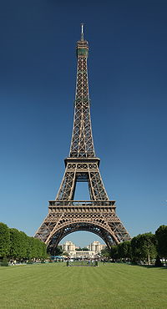
Height
300 meters
Record
1889 to 1930
Notes
First structure to surpass 300 meters

Slide 4

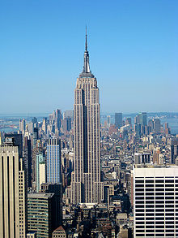
Height
381 meters
Record
1931 to 1967
Notes
One of the first super skyscrapers.

Slide 5

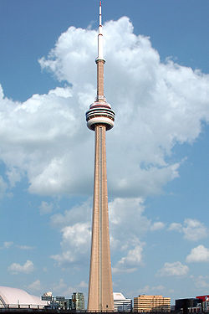
Height
553 meters
Record
1975 to 2007
Notes
Often rivaled by Russia and Asia but still the tallest in the west.

Slide 6

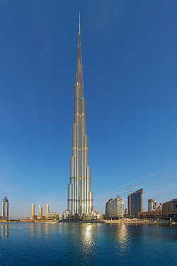
Height
828 meters
Record
2007 to ???
Notes
One of many built and planned in the Middle East and Asia.
How long will it hold the record?

Slide 7

Build the tallest free standing tower
  Using only the limited materials provided in class
Work in teams of 4
  Make a plan before you cut!
  Discuss best use of your materials!
Pay attention to the Rules

Slide 8

Materials – No resupply or second chances
  One piece of ledger size paper,
  one pair of scissors,
  50 cm of tape
Limits
  Use only materials above
  Tower must be free standing
  Cannot be taped down
Timeline
  Planning 5 minutes
  Construction 25 minutes

Slide 9

You need a plan before collecting materials.
Your plan should include
  The name of the members in your group
  How you will cut & shape your paper
  How you will use your tape
  A role / job for each member in your group

Slide 10

Write down a 2 paragraph reflection on building the tower.
Debrief Questions:
  What are some good points about your design?
  What was useful to you understanding the instructions for the activity?
  What roles did each of you play in your group to help accomplish the goal?
  How would you improve your design?

